Slide 1

RESEARCH ON DATA ENCRYPTION TECHNOLOGY
Submitted in the partial fulfillment for the award of the degree of
BACHELOR OF ENGINEERING
IN
COMPUTER SCIENCE AND ENGINEERING
Submitted by:
T.Harshitha – 21BCS5848
M.Sandeep Kumar – 21BCS9608
K.Nageswara Reddy – 21BCS5714
B.Nandini – 21BCS4229
Under the Supervision of:
Dr . Sakshi
DISCOVER . LEARN . EMPOWER

Slide 2






INDEX OF PROJECT EVALUATION -1
IDEA
Introduction
Problem Formulations
Objective
Methodology
Conclusion
Research on Data Encryption
Future Scopes & Research

Slide 3







INTRODUCTION
Data encryption technology ensures the security of digital information by transforming it into unreadable formats, preventing unauthorized access
This project explores the effectiveness of cryptographic techniques in maintaining data privacy and ensuring information integrity.
It focuses on prominent encryption algorithms like AES and RSA, analyzing
their role in safeguarding sensitive data.
The integration of encryption into security protocols such as SSL/TLS is studied to understand its importance in secure communication.
Emerging advancements like quantum-safe cryptography and blockchain security are investigated to address future challenges in the field.
Real-world applications of encryption across industries, including healthcare,
finance, and e-commerce, are examined to highlight its practical significance.
The study emphasizes the critical need for encryption in combating modern cyber threats while fostering awareness about its vital role in technological innovation.

Slide 4








PROBLEM FORMULATION
08 -awareness
01 -Security
07 -threats
02 - integrity
06 -applications
03 – algorithms
05 -advancements
04 -protocals

Slide 5
1
2
3
.
Understanding
Security
Implementation
4
OBJECTIVES
5
Optimization
Protection
8
7
6
Adaptation
Development
Encryption

Slide 6
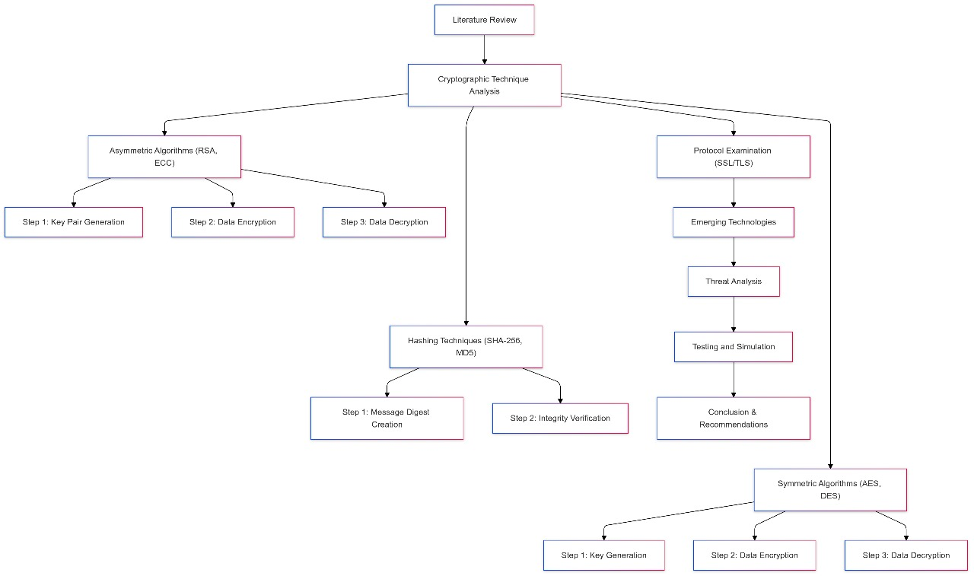
METHODLOGY

Slide 7
Data Collection Plan
Algorithm Performance Analysis
Cybersecurity Threat Data
Benchmark encryption algorithms using controlled simulations and experiments.
Expert Opinions
Collect statistics on encryption-related cyber threats and data breaches..
Conduct interviews and surveys with cybersecurity professionals and cryptography experts.
Regulatory Compliance Research
Case Studies
Analyze real-world encryption applications in industries like finance, healthcare, and cloud computing
Review global data protection laws (GDPR, HIPAA, PCI-DSS) and their encryption requirements.
Emerging Technology Review
Literature Review
Gather data for AI training, validation, and system optimization
Study advancements in quantum-safe cryptography, homomorphic encryption, and blockchain security.
Data Encryption
7

Slide 8
FEASIBILITY ANALYSIS
01
Assessing encryption algorithm effectiveness.
02
Ensuring smooth integration into systems.
03
Evaluating cost-effectiveness of encryption.
04
Compliance with data protection regulations.
05
Adapting encryption for growing data needs.
06
Protecting against evolving cyber threats.
8

Slide 9
INNOVATIVE ELEMENTS
08
Multi-Factor Encryption – Combining multiple cryptographic methods for enhanced security.
07
Post-Quantum Cryptography – Exploring lattice-based and hash-based encryption techniques.
06
Zero-Trust Architecture – Applying encryption in a zero-trust security framework.
05
Lightweight Cryptography – Developing efficient encryption for IoT and mobile devices
04
03
AI-Driven Encryption – Enhancing security with adaptive AI-based cryptographic models.
Blockchain Security – Using decentralized encryption for data integrity.
01
02
Homomorphic Encryption – Enabling computation on encrypted data without decryption..
Quantum-Safe Encryption – Implementing cryptography resistant to quantum attacks
9

Slide 10
Results
https://colab.research.google.com/drive/1v3qcDNl1ruks4OXcJE3Bb9spEfxmoPZT

Slide 11
Conclusion and Future scope
CONCLUSION
FUTURE SCOPE
Cryptographic techniques are fundamental to ensuring the confidentiality, integrity, and authenticity of data in digital communication systems.
The future of cryptography will involve the development of algorithms that are resistant to the threats posed by quantum computing.
Data Encryption
Technology
Enhancements
DEVELOPMENT
Research will aim to optimize cryptographic algorithms for better performance and lower resource consumption.
The development and standardization of cryptographic algorithms that are resistant to quantum computing will be critical for future secure communications.

Slide 12
References
[1] Kim, T.S., Sohn, S.Y.: Machine-learning-based deep semantic analysis approach for forecasting new technology convergence. Technological Forecasting and Social Change 157, 120095 (2020)
[2] He, C., Shi, F., Tan, R.: A synthetical analysis method of measur ing technology convergence. Expert Systems with Applications 209, 118262(2022).
[3] Lin, J. (2024). Research on the application of data encryption technology in computer network communication security. Digital Communication World, 2024(04), 125-127.
[4] Sun, D. X., Liu, D. J. (2023). A brief analysis of the application value of data encryption technology in computer network security. Information Systems Engineering, 2023(08), 52-55.
[5] Wang, J. X. (2023). Application of data encryption technology in computer network information security. Digital Communication World, 2023(07), 141-143.

Slide 13
THANK YOU

